Slide 1
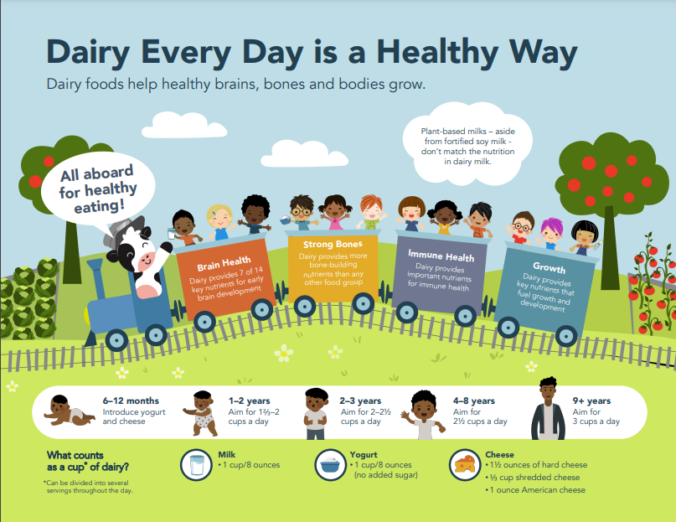
Plant-based milks – aside from fortified soy milk - don’t match the nutrition in dairy milk.
Be sure to read
the food label.
Notes:
Thanks so much for agree to be part of this nationwide pilot to assess the impact of nutrition education about dairy foods and their role in optimal child growth and development.

Slide 2
Parents are Hungry to Confidently Nourish Their Children
Child-Rearing Topics on Which Parents Report Seeking Information
Which Parenting Sources Do Parents Trust?
(Percent ”yes” illustrated)
Immediate Family
Doctors &
Healthcare Providers
Teachers & Child Care Providers
Other Professionals
Source: Zero to Three National Survey 2018, (N=1,002), +/- 3.1%
Source: Zero to Three. Millennial Connections. https://www.zerotothree.org/resources/2475-millennial-connections-executive-summaryhttps://www.zerotothree.org/resources/2475-millennial-connections-executive-summary
Notes:
It likely comes as no surprise to you that nutrition is one of the top topics parents are seeking information. However, only one-third (34%) are confident they are doing a good job shaping their child’s eating habits.² The good news is they clearly see their pediatric team as their parenting partner.
Sources
1. https://www.zerotothree.org/resources/series/national-parent-survey-millennial-connections
2. https://mottpoll.org/reports-surveys/healthy-eating-children-parents-not-following-recipe

Slide 3




Healthy Eating Declines in Childhood
An Opportunity to Set the Stage for a Lifetime of Wellness
Healthy Eating Index Scores Across Childhood and Adolescence
80
61
55
52
60
51
40
Maximum Total Score=100
20
0
Ages 2–4
Ages 5–8
Ages 9–13
Ages 14–18
Data Source: Analysis of What We Eat in America, NHANES 2015–2016, age 2 and older, day 1 dietary intake data, weighted.
2020-2025 Dietary Guidelines for Americans
Notes:
Providing nutrition education and guidance for families of young children can help them build healthy habits and set them on the lifelong path to wellness. But the reality is, adherence to the Dietary Guidelines recommendations (as measure by the Healthy Eating Index) is best (but not great) early in life and quicky starts to decline in childhood and adolescence.
Source:
https://www.dietaryguidelines.gov. Chapter 1 page 26.

Slide 4
The Dairy Gap is Evident at a Shockingly Early Age
Black 2-5 year olds >1 serving short/day and the trend continues
9 years - adulthood
4 - 5 years
6 - 8 years
Asian
Hispanic
White
2 - 3 years
Black
Average total dairy servings per day
*
*
*
*
*
*
*
*
* Significantly different than Non-Hispanic White
Notes:
The gaps between recommendations and actual consumption is evident at a shockingly early age. By 2-3 years black children are lagging behind recommendations and by 4 everyone is not meeting recommendations…placing them at significant risk of missing out on the important nutrients dairy foods provide, which in turn puts them at risk of not reaching their full growth and developmental potential.
These early years are for nurturing and nutrition. Investing in the nutrition conversation with families now can help children learn to like healthy foods and set the stage for a lifetime of wellness.
______________________________________________________________________________
Background Information. These graphs represent dairy consumption across the lifespan by age and ethnicity.
Each set of bar graphs represents age bands:
2 to 5 year olds,
6 to 11 year olds,
12 to 18 year olds and
those 30+.
The bar colors represent ethnicities:
Green is Non-Hispanic White,
Dark Blue is Non-Hispanic Black,
Orange is Non-Hispanic Asian, and
Blue is Hispanic.
And the light blue lines above each graph indicate the recommended number of dairy servings for that age group.
What we see with dairy consumption is similar to the HEI scores, where consumption is closest to the recommendations early in life, but the gap in actual consumption compared to recommendations widens across childhood, adolescence and into adulthood. And these graphs show clearly that people of color – black children in particular - are at significant risk of missing out on the important nutrients dairy foods provide and that puts them at risk of not reaching their full growth and developmental potential.
Source: NHANES

Slide 5




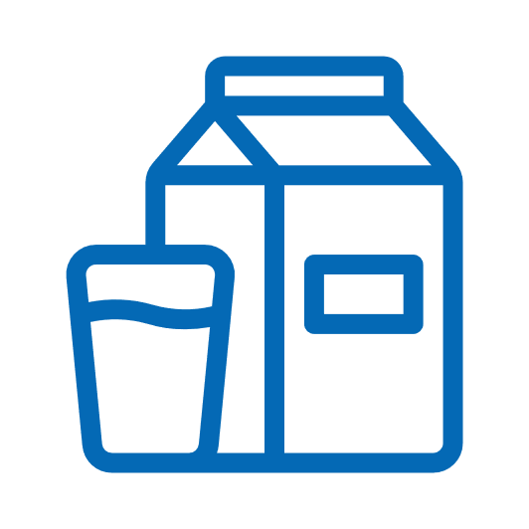


Dairy Everyday is a Healthy Way to
Help Nourish Brains, Bones and Bodies
Brain Buddy
Bone Builder
Immune Important
Growth & Development
NUTRIENT | FUNCTION | MILK | YOGURT | CHEESE
Protein | l l l l
Calcium | l l
Potassium¹ | l l
Phosphorus | l l
Iodine | l l
Selenium | l l l
Zinc | l l l
Vitamin A | l l l l
Vitamin D | l l l |  | If fortified | If fortified
Vitamin B2 (riboflavin) | l
Vitamin B3 (niacin) | l
Vitamin B5 (pantothenic acid) | l
Vitamin B12 (cobalamin) | l l l
Choline² | l l
FDA’s Daily Value (DV) for potassium of 4700 mg is based on a 2005 DRI recommendation. In 2019, NASEM updated the DRI to 3400 mg. Based on the 2019 DRI, a serving of milk provides 10% of the DRI. FDA rule-making is needed to update this value for the purpose of food labeling.
Milk provides 8% of the Daily value for choline
Notes:
To get a better understanding on the most compelling dairy topics for pediatricians and parents, National Dairy Council conducted qualitative research earlier this year and found the topics that rose to the top were:
Brain health
Bone health
Growth and development and
Overall health and immunity
The good news the nutrients in dairy foods deliver on these top topics.

Slide 6
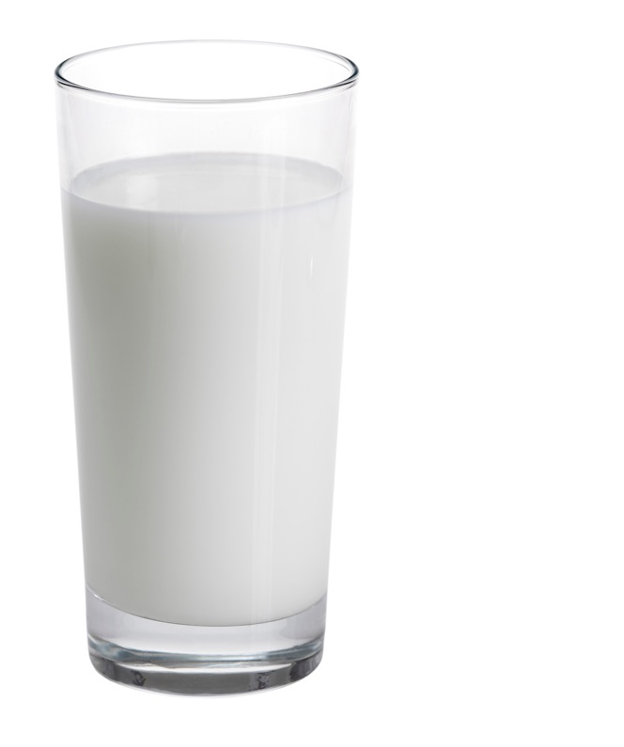


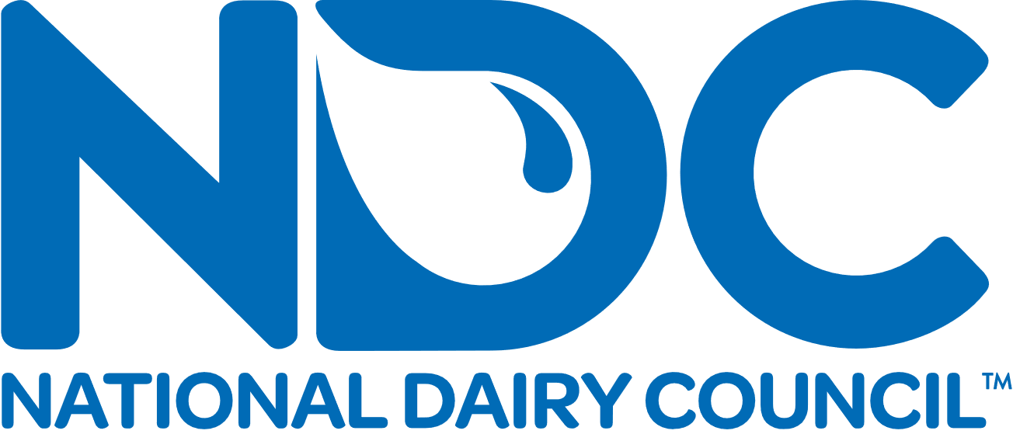
Dollar for Dollar, Dairy Foods Are One of the Most Economical Sources of Nutrition
Least Expensive Sources of the
Nutrients of Public Health Concern
Children 2-18 Years
Adults 19-99 Years
CALCIUM
1. Cheese & milk (dairy)
(TIE)
2. Orange juice
CALCIUM
1. Milk (dairy)
2. Cheese
3. Orange juice
Excellent Source
Pantothenic Acid
Phosphorus
Vitamin B12
~20¢
Calcium
Iodine
Riboflavin
VITAMIN D
1. Milk (dairy)
2. Eggs
3. Fortified cereals
VITAMIN D
1. Milk (dairy)
2. Eggs
3. Soy Milk
Per serving*
POTASSIUM
1. Potatoes & sweet potatoes
2. Juice
3. Milk (dairy)
POTASSIUM
1. Potatoes & yams
2. Juice
3. Milk (dairy)
Good Source
Protein
Vitamin D
Vitamin A
Niacin
Potassium
Selenium
Zinc
FIBER
1. Quinoa
2. Chickpeas
3. Pearled barley
FIBER
1. Quinoa
2. Chickpeas
3. Pearled barley
*Based on U.S. average price of unflavored, private label milk, 1 gal.
[Source: IRI Total US - Multi Outlet + Conv 2022 YTD ending 5-22]
USDA FoodData Central (FDC ID: 602770) Drewnowski, A. J Am Coll Nutr. 2011. Hess, JM. Nutr J. 2019.
Notes:
Dairy foods can be a nutrition solution for many families. Dollar for dollar, dairy foods are one of the most economical sources of nutrition. And the good news is they come in several textures and varieties…..(next slide)
---------------
Additional Information
According to the 2015-2020 Dietary Guidelines for Americans, there are 10 ”shortfall nutrients” that many Americans do not get enough of in their diets. Four of these nutrients – calcium, vitamin D, potassium and fiber – have been identified as “nutrients of public health concern” because their underconsumption has been linked to adverse health outcomes. This analysis of National Health and Nutrition Examination Survey data (NHANES 2011-2014) compared the cost of obtaining nutrients of public health concern from the various food groups to help identify cost- effective ways for Americans to move closer to healthy and sustainable eating patterns.
In fact, Milk and Dairy Foods were the least expensive source of calcium and vitamin D and the 3rd least expensive source of potassium in children’s diets. Replacing milk or dairy foods with other foods results in higher costs to get the same nutrients.
Sources:
1. A serving of milk costs, on average, $0.20 Based on U.S. average price of unflavored, branded and private label milk, 1 gal. Source: IRI Multi Outlet + Conv 2020, YTD ending 10-4-20] The majority of unflavored milk purchases in the U.S. cost about $0.18 per serving. IRI Multi Outlet + Conv 2020, YTD ending 10-4-20] Dollar for dollar, dairy foods are one of the most economical sources of nutrition.
2. Drewnowski A, et al. The contribution of milk and milk products to micronutrient density and affordability of the U.S. diet. J Am Coll Nutr. 2011;30(5 Suppl 1): p. 422S-8S.
3. Hess JM, Cifelli CJ, Agarwal S, Fulgoni VL 3rd. Comparing the cost of essential nutrients from different food sources in the American diet using NHANES 2011-2014. Nutr J. 2019;18(1):68.

Slide 7

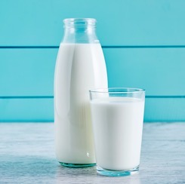
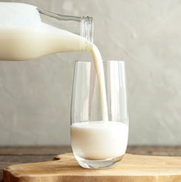
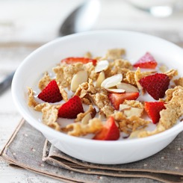




Issues with Lactose?
There is Something for Everyone
Helpful Reminders
Test and tailor to find for what works
Lactose intolerance is an individualized condition
An expert panel found most people
who have trouble digesting lactose
can tolerate ~12 grams at one time
Lactose-free milk is real dairy milk.
It provides the same 13 nutrients,
just without the lactose
Most hard, natural cheese
contain minimal lactose
Yogurt’s live and active cultures
help digest lactose
Greek and Icelandic yogurt have less lactose due to the straining process
Try It
Sip It
Stir It
Opt for lactose-free dairy milk products
Start small and introduce dairy slowly
Mix milk with other foods to help slow lactose digestion
Slice It
Shred It
Spoon It
Choose natural cheeses
(e.g., Cheddar, Swiss)
Add natural cheeses to foods (e.g., Parmesan)
Yogurt’s live and active cultures help digest lactose
National Medical Association Consensus Statement. 2013.
Notes:
….Including lactose free. In addition, hard cheese and yogurt are great choices for people with lactose intolerance. These are some easy tips for those with LI
So - aside from the 2% who may experience an actual milk protein allergy – there is something in the dairy case for everyone….so they can enjoy the benefits of dairy foods and there’s likely something even picky eaters will like.
Sources:
2013 Consensus Statement: https://www.usdairy.com/getmedia/5f2b01d0-9fda-4677-99ca-b4d69550dbc5/2013%20nma%20consensus%20report%20li%20and%20health%20disparities%20among%20african%20americans%20and%20hispanics.pdf.pdf.aspx
NDC Science Summary: Lactose Intolerance and Dairy Innovation: https://www.usdairy.com/getmedia/6e574c5d-9f03-48b3-af86-de68f9dd8035/Science-Summary-Dairy-Innovation-2021.pdf?ext=.pdf

Slide 8

Components
Family educational resources (English and Spanish)
Posters
Detailed pediatric care specialist background resources
Notes:
We developed resources to help you have conversations with the families you work with on these important topics. This information is available in English and Spanish as a family education handout, as well as a poster for your waiting rooms or exam rooms.
I’d like to share a little more information on the evidence supporting these four topics.
There is also a backgrounder you can refer with more detailed information and scientific resources and FAQs.

Slide 9



3 Fundamental Components to Neurodevelopment and Lifelong Wellbeing
When one or more of these components is absent, there can be negative effects on a child’s physical, social, emotional and cognitive development.
Appropriate nutrition
Responsive caregiver relationships
Safe and nurturing environments
Harvard University. Center on the Developing Child. (2010).
DevelopingChild.Harvard.edu. The Foundations of Lifelong Health Are Built in Early Childhood.
ThousdandDays.org. The First 1,000 Days: Nourishing America's Future.
Notes:
Let’s jump into the evidence on for neurodevelopment.
Of course, there are several key components in neurodevelopment that affect lifelong health. We have variable control over these components, but nutrition in the first 1000 days, is an area that we can support through education and resources.
Sources
DevelopingChild.Harvard.edu. The Foundations of Lifelong Health Are Built in Early Childhood. https://developingchild.harvard.edu/wp-content/uploads/2010/05/Foundations-of-Lifelong-Health.pdf
ThousdandDays.org. The First 1,000 Days: Nourishing America's Future. https://thousanddays.org/wp-content/uploads/1000Days-NourishingAmericasFuture-Report-FINAL-WEBVERSION-SINGLES.pdf

Slide 10

Dairy Every Day is a Healthy Way to Support Brain Development
GLUCOSE
Dairy foods offer
7 of the 14 nutrients AAP notes as important for early cognitive development.
Macronutrients
PROTEIN
SPECIFIC FATS*
IRON
COPPER
Minerals
ZINC
SELENIUM
IODINE
CHOLINE
VITAMIN K
FOLATE
Vitamins &
Vitamin-like Nutrients
VITAMIN B6
VITAMIN B12
VITAMIN A
Schwarzenberg SJ, Georgieff MK, AAP COMMITTEE ON NUTRITION. Pediatrics. 2018;141(2):e20173716
Georgieff MK, Brunette KE, Tran PV. Dev Psychopathol. 2015;27(2):411-423.
USDA, ARS. FoodData Central, 2019. fdc.nal.usda.gov
Green shading indicates nutrients in dairy foods
*Long-chain polyunsaturated fatty acids
Notes:
In its Policy Statement on Advocacy for Improving Nutrition in the First 1000 Days to Support Childhood Development and Adult Health, the American Academy of Pediatrics recognized 14 nutrients that affect early brain development.
Dairy foods are a brain health powerhouse, providing 7 of the 14 nutrients important for early brain development
Source:
Sarah Jane Schwarzenberg, Michael K. Georgieff, COMMITTEE ON NUTRITION, Stephen Daniels, Mark Corkins, Neville H. Golden, Jae H. Kim, C. Wesley Lindsey, Sheela N. Magge; Advocacy for Improving Nutrition in the First 1000 Days to Support Childhood Development and Adult Health. Pediatrics February 2018; 141 (2): e20173716. 10.1542/peds.2017-3716. https://publications.aap.org/pediatrics/article/141/2/e20173716/38085/Advocacy-for-Improving-Nutrition-in-the-First-1000?autologincheck=redirected

Slide 11
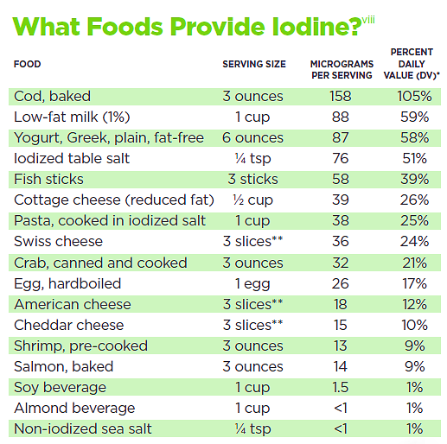



Seafood, Dairy Foods and Eggs Offer Natural Sources of Iodine
DAIRY MILK
59% DV
FISH STICKS
39% DV
EGG
17% DV
*The DV for iodine is 150 mcg for healthy adults and children over 4.
**Cracker sized slice of cheese
USDA, FDA and ODS-NIH Database for the Iodine Content of Common Foods per serving, Release 2. January 2022.
National Dairy Council. The Importance of Iodine in Prenatal Brain Development. May 2022.
Centers for Disease Control. Second Nutrition Report Factsheet. Iodine Levels in Young Women Boarder on Insufficiency. April 2012.
Notes:
And what pregnant and breastfeeding moms eat matters too. Iodine is particularly important as iodine deficiency as the CDC notes it is the most preventable cause of intellectual disability in the world.
According to the 2020-2025 Dietary Guidelines for Americans women who do not regularly consume dairy products, eggs, seafood, or use iodized table salt may not consume enough iodine ─ which is essential for neurocognitive development of the fetus.
While many people assume that plant-based alternatives have similar nutrition, it is important to note that is not always true. Even soy beverage – which is the only alternative recommended in the Dietary Guidelines - has negligible amounts of iodine,
Sources
USDA, FDA and ODS-NIH Database for the Iodine Content of Common Foods per serving, Release 2. January 2022.
https://www.ars.usda.gov/northeast-area/beltsville-md-bhnrc/beltsville-human-nutrition-research-center/methods-and-application-of-food-composition-laboratory/mafcl-site-pages/iodine/
National Dairy Council. The Importance of Iodine in Prenatal Brain Development. May 2022.
https://www.usdairy.com/getmedia/32a32c4a-5e31-4f35-80c3-2c64e68dde49/NDC-Iodine-Prenatal-Handout-FINAL.pdf?ext=.pdf
Centers for Disease Control. Second Nutrition Report Factsheet. Iodine Levels in Young Women Boarder on Insufficiency. April 2012.
https://www.cdc.gov/nutritionreport/pdf/Second-Nutrition-Report-Iodine-Factsheet.pdf
Levels in Young Women Boarder on Insufficiency. April 2012.
https://www.cdc.gov/nutritionreport/pdf/Second-Nutrition-Report-Iodine-Factsheet.pdf

Slide 12



Key Points to Help Parents Nourish Their Child’s
Brain Development
Dairy every day
is a healthy way to benefit brain health
Help nourish baby’s brain development with the iodine and other important nutrients found in
dairy foods.
Dairy foods are a brain health powerhouse, providing 7 of the 14 nutrients important for early brain development.
Notes:
These key points can help you support families to nourish their child’s brain development.
Dairy every day is a healthy way to benefit brain health.
Dairy foods are a brain health powerhouse, providing 7 of the 14 nutrients important for early brain development.
Help nourish baby’s brain development with the iodine and other important nutrients found in dairy foods.

Slide 13
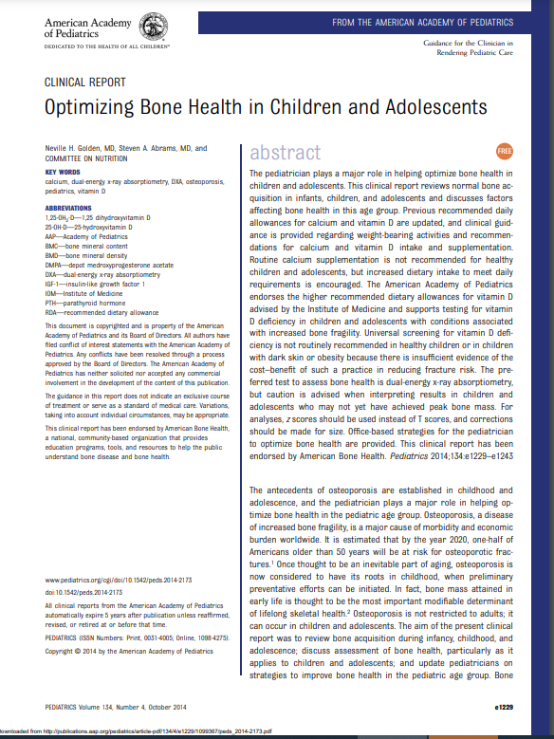

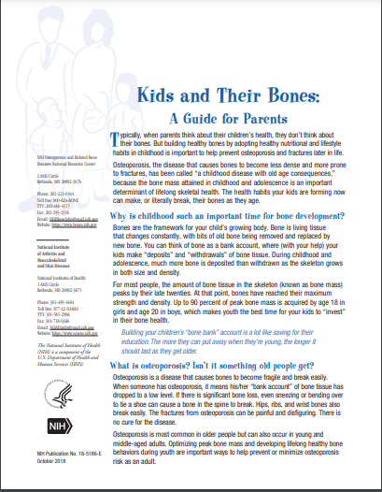



Dairy Every Day is a Healthy Way to Build Strong Bones
The AAP, NIH and Dietary Guidelines recommend eating dairy foods daily to achieve peak bone mass
Notes:
The health habits children build early in life can make or literally break their bones as they age. The more bone mass created during childhood and adolescence, the greater the chance of preventing osteoporosis and related injuries later in life. The American Academy of Pediatrics, National Institutes of Health and 2020-2025 Dietary Guidelines for Americans recommend eating dairy foods daily to achieve peak bone mass.
Sources
Neville H. Golden, Steven A. Abrams, COMMITTEE ON NUTRITION, Stephen R. Daniels, Steven A. Abrams, Mark R. Corkins, Sarah D. de Ferranti, Neville H. Golden, Sheela N. Magge, Sarah Jane Schwarzenberg; Optimizing Bone Health in Children and Adolescents. Pediatrics October 2014; 134 (4): e1229–e1243. 10.1542/peds.2014-2173
U.S. Department of Agriculture and U.S. Department of Health and Human Services. Dietary Guidelines for Americans, 2020-2025. 9th Edition. December 2020. Available at DietaryGuidelines.gov
NIH. Kids and Their Bones. A Guide for Parents. https://www.bones.nih.gov/health-info/bone/bone-health/juvenile

Slide 14

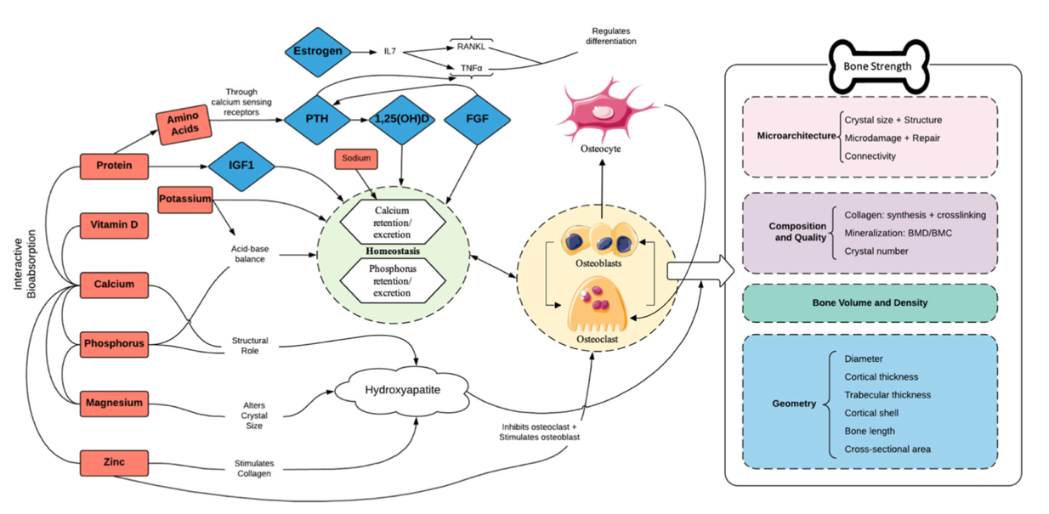
Bones Crave the Nutrients Found in Dairy Foods
Impact of Dairy Nutrients on Bone Strength
  Protein provides the structural matrix of the bone.
  Calcium plays a structural role in bone.
  Vitamin D is required for
  calcium absorption.
  Phosphorus promotes bone strength and the body's acid base balance.
  Potassium promotes an alkaline environment helping to preserve calcium in bones.
  Zinc stimulates collagen production, a key component for strong bones.
American Academy of Pediatrics. Clinical Report: Optimizing Bone Health in Children and Adolescents.
Wallace, T, et al. Critical Reviews in Food Science and Nutrition. 2020.
Cristina Palacios Ph.D. (2006) The Role of Nutrients in Bone Health, from A to Z, Critical Reviews in Food Science and Nutrition, 46:8, 621-628, DOI: 10.1080/10408398.2020.1810624
Notes:
While most people think of calcium and vitamin D when it comes to bone health, the reality of it is there a variety of nutrients that impact bone strength. And as you can see here, many of them work together so the totality of the dairy matrix is important and needs to be taken into consideration when it comes to supplements and dairy alternatives.
SOURCES:
American Academy of Pediatrics. (2014) Optimizing Bone Health in Children and Adolescents. https://pediatrics.aappublications.org/content/pediatrics/134/4/e1229.full.
Wallace TC, Bailey RL, Lappe J, O’Brien KO, Wang D, Sahni S, Weaver CM. (2020) Dairy intake and bone health across the lifespan: a systematic review and expert narrative, Critical Reviews in Food Science and Nutrition, DOI: 10.1080/10408398.2020.1810624
https://www.tandfonline.com/doi/abs/10.1080/10408390500466174

Slide 15





Key Points to Help Parents Nourish Their Child’s Bone Health
Dairy every day is a healthy way to build strong bones and muscles
Building your child’s “bone bank” is like saving for their education. Investing in good nutrition now, will pay off with stronger bones in the future.
Dairy foods provide bone-building vitamins and minerals.
Bones crave the nutrients found in milk, yogurt and cheese.
Milk with meals is an easy way to build the bone bank.
Notes:
These key points can help you support families to nourish their child’s bone health.
Dairy every day is a healthy way to build strong bones and muscles.
Building your child’s “bone bank” is like saving for their education. Investing in good nutrition now, will pay off with stronger bones in the future.
Dairy foods provide bone-building vitamins and minerals.
Bones crave the nutrients found in milk, cheese and yogurt.
Milk with meals is an easy way to build the bone bank.

Slide 16

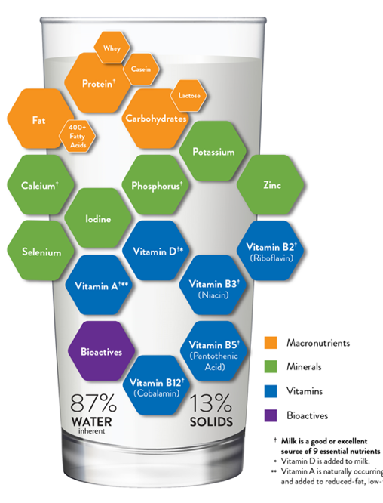
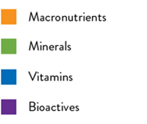
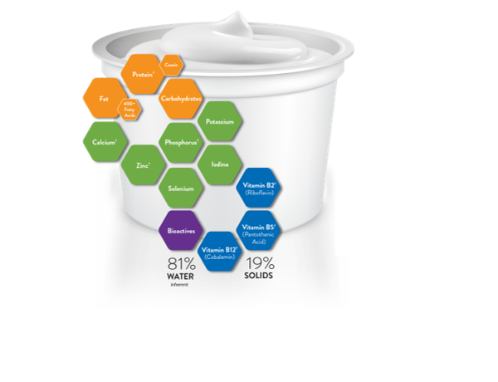
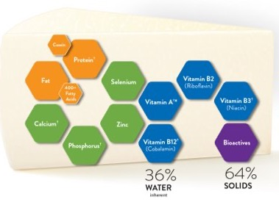
Dairy Every Day is a Healthy Way to Benefit Immunity
Immunity-important Nutrients
Protein (Milk, Cheese, Yogurt)
Selenium (Milk)
Zinc (Milk, Yogurt)
Vitamins
A (Milk, Cheese Fruits, Vegetables)
B6 (Fruits, Vegetables)
B12 (Milk, Cheese, Yogurt)
C (Fruits, Vegetables)
D (Milk)
E (Nuts, Seeds)
† Milk is a good or excellent source of 13 essential nutrients
† Yogurt is a good or excellent source of 7 essential nutrients
† Cheese is a good or excellent source of 6 essential nutrients
FDA’s Daily Value (DV) for potassium of 4700 mg is based on a 2005 DRI recommendation.
In 2019, NASEM updated the DRI to 3400 mg. Based on the 2019 DRI, a serving of milk provides 10% of the DRI. FDA rule-making is needed to update this value for the purpose of food labeling.
Milk – Food Data Central: 1077
Greek Yogurt - Food Data Central: 171304
Cheddar Cheese - Food Data Central: 170899
*Vitamin D is added to milk
**Vitamin A is naturally occurring in whole milk and added to reduced-fat, low-fat and fat-free milks
Notes:
Healthy immune systems are top of mind for just about everyone. Smart habits to help immune health include getting enough sleep, regular exercise, managing stress and eating a healthy diet.
Immune cells require a constant supply of energy and nutrients as they are defending and protecting the body. Nutrients from a variety of foods, including dairy foods, fruits and vegetables, help keep our immune system in check
As noted earlier, children’s diet quality becomes sub-optimal at an early age. This is especially concerning for Non-Hispanic Black children and Hispanic children because they miss the mark on meeting nutrition recommendations more than their peers.
Dairy foods provide immune important nutrients like
Protein
Selenium
Zinc
Vitamins A, B12, and D

Slide 17



Key Points to Help Parents Nourish Their Child’s Immune System
Dairy every day
is a healthy way to benefit immunity
Nourish your child’s immune system
with the nutrients
in dairy foods.
Dairy foods provide nutrients, as part of a healthy diet, important for immune health.
Notes:
These key points can help you support families to nourish their child’s immunes system.
Dairy every day is a healthy way to benefit immunity.
Nourish your child’s immune system with the nutrients in dairy foods.
Dairy foods provide nutrients, as part of a healthy diet, important for immune health.

Slide 18




Dairy Every Day is a Healthy Way to Support Growth and Development
Establishing Healthy Habits to Last a Lifetime
Cheese
Cheese comes in a variety of textures from soft and solid, like Cheddar cheese, to lumpy, like cottage cheese.
Cheese can also introduce a variety of tastes
such as mild, sharp and tangy.
Yogurt
Whole milk yogurt (plain, unsweetened) introduces a creamy texture and slightly sour taste.
Yogurt also contains good bacteria, which helps to support digestion at all ages.
https://www.usdairy.com/getmedia/a0fcbb3d-7659-4199-9cec-3b7e196cce6e/NDC_Dairy_Through_Lifespan_Booklet_FINAL-singlepages.pdf
Notes:
Early childhood is a critical period for growth and development, which require the right balance of nutrients, including high-quality protein, while keeping weight gain on the right track. It is also key time to learn to like healthy foods and establish habits to nourish a lifetime of wellness.
At around six months of age, as nutrient-dense complementary foods are introduced, cheese and yogurt are easy ways to familiarize babies to new tastes and textures.
After baby’s first birthday, as they transition from breast milk or iron-fortified formula, whole milk and other dairy foods emerge as sources of calories, high-quality protein and other nutrients to build healthy brains, bones, bodies and immune systems. This nutrient bundle makes dairy foods an easy safety net for picky eaters. Dairy foods are also versatile in flavor and texture and pair well with fruits, vegetables and whole grains.
Source:
U.S. Department of Agriculture and U.S. Department of Health and Human Services. Dietary Guidelines for Americans, 2020-2025. 9th Edition. https://www.dietaryguidelines.gov/sites/default/files/2021-03/Dietary_Guidelines_for_Americans-2020-2025.pdf

Slide 19
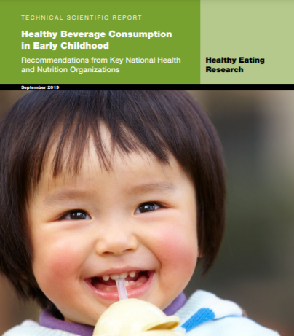





Milk and Water: Go-to Beverages for 1-5 Year Olds
Leading Health Authorities Agree
“Plain cow’s milk is a common, familiar beverage in U.S. diets, and its availability, affordability, and nutrient density make it a good choice for healthy, growing children.”
12-24 MONTHS
It’s time to add whole milk, which has many essential nutrients, along with plain drinking water for hydration. A small amount of juice is ok, but make sure it’s 100% fruit juice to avoid added sugar. Better yet, serve small pieces of real fruit, which are even healthier.
2-5 YEARS
Milk and water are the go-to beverages. Look for milks with less fat than whole milk, like skim (non-fat) or low fat (1%). If you choose to serve 100% fruit juice, stick to a small amount, and remember adding water can make a little go a long way!
Healthy Eating Research. Technical Scientific Report. Healthy Beverage Consumption in Early Childhood
Recommendations from Key National Health and Nutrition Organizations
Healthy Eating Research. Healthy Drinks. Healthy Kids. Summary Flyer
Notes:
Research shows that what children drink – from birth through age 5 – can have a big impact on their health. Experts at the American Academy of Pediatrics, the Academy of Nutrition and Dietetics, the American Academy of Pediatric Dentistry and the American Heart Association recommend cow’s milk and water as the go-to beverages for children 1-5 years of age.
Plant-based alternatives are not recommended due to their wide variability in nutrient content, limited evidence of bioavailability and impact on diet quality and health outcomes. The exception would be unsweetened, fortified soy milk if a child is allergic to dairy milk or to accommodate vegan or certain vegetarian dietary preferences. These recommendations mirror guidance from North American Society for Pediatric Gastroenterology, Hepatology, and Nutrition and the 2020-2025 Dietary Guidelines for Americans
Sources
Healthy Eating Research. Technical Scientific Report. Healthy Beverage Consumption in Early Childhood. Recommendations from Key National Health and Nutrition Organizations. September 2019. https://healthydrinkshealthykids.org/app/uploads/2019/09/HER-HealthyBeverageTechnicalReport.pdf
Merritt RJ, Fleet SE, Fifi A, et al. North American Society for Pediatric Gastroenterology, Hepatology, and Nutrition Position Paper: Plant-based Milks. J Pediatr Gastroenterol Nutr. 2020;71(2):276-281. doi:10.1097/MPG.0000000000002799 https://pubmed.ncbi.nlm.nih.gov/32732790/
https://healthydrinkshealthykids.org/press/
https://healthydrinkshealthykids.org/parents/
Technical Scientific Report: https://healthydrinkshealthykids.org/app/uploads/2019/09/HER-HealthyBeverageTechnicalReport.pdf
Consensus Statement: https://healthydrinkshealthykids.org/app/uploads/2019/09/HER-HealthyBeverage-ConsensusStatement.pdf

Slide 20
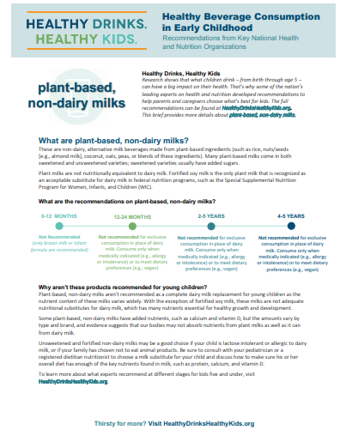

Plant-Based Dairy Alternatives
Not Recommended for Young Children as “Nutrient Content Varies Widely”
Why aren’t these products recommended for young children?
Plant-based, non-dairy milks aren’t recommended as a complete dairy milk replacement for young children as the nutrient content of these milks varies wildly. With the exception of fortified soy milk, these milks are not adequate nutritional substitutes for dairy milk, which has many nutrients essential for healthy growth and development.
Some plant-based, non-dairy milks have added nutrients, such as calcium and vitamin D, but the amounts vary by type and brand, and evidence suggests that our bodies may not absorb nutrients from plant milks as well as it can from dairy milk.
To learn more about what experts recommend at different stages for kids five and under, visit HealthyDrinksHealthyKids.org.
See the full guidelines and learn more at HealthyDrinksHealthyKids.org
https://healthydrinkshealthykids.org/app/uploads/2019/09/HDHK_One_Pager_Plant-Based-Non-Dairy-Milks.pdf
Notes:
The expert panel concluded that plant-based dairy alternatives aren’t recommended as a complete substitute for dairy milk for young children for a couple of reasons.
One is that the nutrient content of these milks varies widely.
The other reason is that the nutrients may not be as bioavailable from plant-based alternatives to cow’s milk.
SOURCE:
Healthy Eating Research. Healthy Drinks. Healthy Kids. 2019. https://healthydrinkshealthykids.org/app/uploads/2019/09/HDHK_One_Pager_Plant-Based-Non-Dairy-Milks.pdf

Slide 21

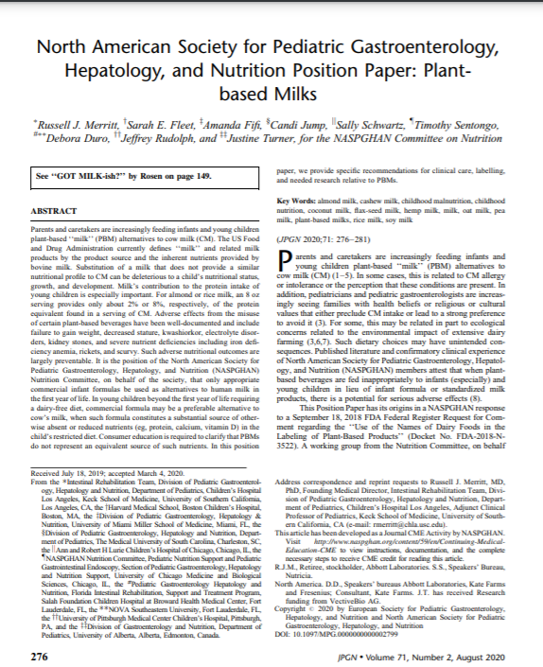

North American Society for Pediatric Gastroenterology, Hepatology & Nutrition
“Substitution of a milk that does not provide a similar nutritional profile to cow’s milk can be deleterious to a child’s nutritional status, growth, and development.”
“Milk’s contribution to the protein intake of young children is especially important. For almond or rice milk, an 8 oz serving provides only about 2% or 8%, respectively, of the protein equivalent found in a serving of cow’s milk.”
“Adverse effects from the misuse of certain plant-based beverages have been well-documented and include failure to gain weight, decreased stature, kwashiorkor, electrolyte disorders, kidney stones, and severe nutrient deficiencies including iron deficiency anemia, rickets, and scurvy.
Such adverse nutritional outcomes are largely preventable.”
Continuing ed credits via NASPGHAN
North American Society for Pediatric Gastroenterology, Hepatology, and Nutrition Position Paper: Plant-based Milks
https://naspghan.org/wp-content/uploads/2020/07/North_American_Society_for_Pediatric.30.pdf
Journal of Pediatric Gastroenterology and Nutrition - Volume 71, Number 2, August 2020
Notes:
As I mentioned, The North American Society for Pediatric Gastroenterology, Hepatology and Nutrition reiterated these same concerns in its position on plant-based beverages which caution against plant-based alternatives, calling out dairy milk’s nutritional package, protein quality and risks associated with plant-based beverages on child growth and development, which are largely preventable.
You can learn more and receive continuing education credits through the QR codes on this slide.
SOURCE:
North American Society for Pediatric Gastroenterology, Hepatology, and Nutrition. Position Paper on Plant-based Milks Journal of Pediatric Gastroenterology and Nutrition - Volume 71, Number 2, August 2020.

Slide 22



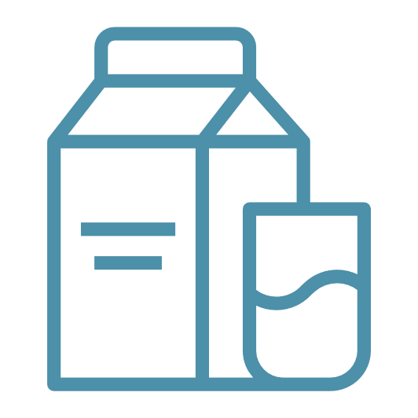
Key Points to Help Parents Nourish
Their Child’s Growth and Development
Dairy every day is a healthy way to support growth and development
Dairy foods have
key nutrients
that fuel growth
and development.
Milk and water are the go-to drinks for 1-5 year olds. Milk for nutrition and water for hydration.
Milk at meals provides a safety net for picky eaters.
When you step away from dairy foods you step down on nutrition.
Notes:
This key points can be helpful in your conversations with parents.
Dairy every day is a healthy way to support growth and development.
Dairy foods have key nutrients that fuel growth and development.
Milk and water are the go-to drinks for 1-5 year-olds. Milk for nutrition and water for hydration.
Milk at meals provides a safety net for picky eaters.
When you step away from dairy foods you step down on nutrition.

Slide 23











Free CEU Webinars Through CDR ⎹ USDairy.com
*
Prenatal Nutrition: Dairy’s Building Blocks for Baby’s Brain Development
Dairy DYK:
Your Top Questions Answered
The Dairy Matrix:
More Than the Sum of Its Nutrients
Confidently Nourishing Children:
What’s the Deal With Dairy?
Taming The Flame—
Dairy And Inflammation
Protein: Plant? Animal?
Health? Planet?
Dairy Nutrition and Bone Health
Get Cultured on Fermented
Dairy Foods
Dairy Innovations
for Sustainable Future Webinar
The Ethics of Hunger.
Nourishing Communities in Need
*
= Elective CME credits offered through AAFP
Notes:
You can learn more about these topics from our archived continuing education webinars – Our recent Prenatal Nutrition webinar offers continuing education credits through AAFP.

Slide 24




Dairy Every Day is a Healthy Way
Dairy foods help healthy brains, bones and bodies grow.
Plant-based milks – aside from fortified soy milk - don’t match the nutrition in dairy milk.
Be sure to read
the food label.
All aboard for healthy eating!
Strong Bones
Dairy foods provide
bone-building
vitamins and minerals.
Immune Health
Dairy foods provide nutrients, as part of a healthy diet, important for immune health.
Brain Health
Dairy foods provide
7 of 14 nutrients key
for early brain development.
Growth
Dairy foods have
key nutrients that
fuel growth and development.
Questions?
Notes:
Thanks so much for agree to be part of this nationwide pilot to assess the impact of nutrition education about dairy foods and their role in optimal child growth and development.

